Slide 1
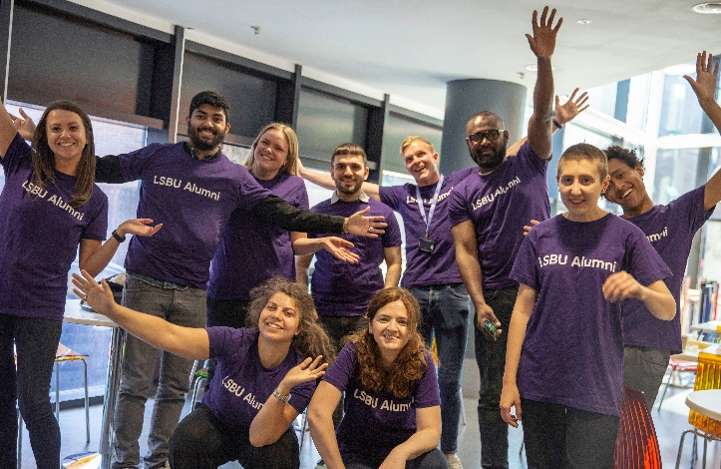
Congratulations Class of 2021! 🎓🎉
Stay connected to LSBU by joining your alumni community here! Alumni.lsbu.ac.uk
Sign up for news, events and fundraising to stay up to date with:
news from our campus
employability services and careers advice
thought provoking events
alumni stories
further study
fundraising activities
volunteering opportunities
access to campus and library
We want to celebrate your success, so drop us an email at alumni@lsbu.ac.uk or tag us on social media to let us know what you’re doing!
@LSBUalumni @LSBUalumni LSBU Alumni Network

Slide 2
Top 6 reasons to join alumni
PG academic scholarship
Exclusive offer of 50% off on Postgraduate study for the Class of 2021.
Employability support
Access Employability Services for up to 2 years after graduation.
The Grad Receive a monthly Class of 2021 graduate newsletter with exclusive content and be the first to know about the latest news, events and opportunities available to you.
Volunteering
Opportunities to give back to the university through volunteering at Open Days, being profiled, speaking on career panels, and much more.
Networking
Opportunities to network with your fellow alumni at events and workshops.
Access card
Access campus (once COVID restrictions have been lifted).
Notes:
Employability services:
A bespoke employability training plan
1-1 support from consultants
CV and interview technique reviews.
access to industry delivered webinars
access to placements, internships and jobs.

Slide 3
Graduate Outcomes
The Graduate Outcomes survey is the biggest UK annual social survey!
You’ll be contacted 15 months after your graduation to learn about your activities and views.
The survey only takes 10 minutes to complete and your response is important in helping to shape the future of higher education.
Find out more here: https://www.graduateoutcomes.ac.uk/

