Slide 1
Subject DIY – Baking Science and Technology BSc (Hons)
Student Recruitment and Outreach Team
outreach@lsbu.ac.uk

Slide 2
Introduction to Subject DIY
Please click the image to begin the introduction

Slide 3
Academic Lecture
Please click the image to begin the lecture

Slide 4
Activity
Please click the image to begin the activity demonstration

Slide 5
Activity Instructions
Instructions:
Place one segment in the fridge, ideally in an airtight container and leave for at least 1 hour. Keep the other segment in an airtight container at room temperature approximately 20C.
When you are ready to taste, wash or sanitise your hands.
Place the chocolate from the fridge on a plate or clean piece of paper or napkin. This is sample 1.
Using your fingers, snap the chocolate in half. How hard is it to snap it ? Record this on the sheet below. Remember there is no right or wrong answer.
Then take a small bite and notice how hard it is to bite through.
Record this on the sheet below.
Keep the chocolate in your mouth and wait for it to melt. Notice whether it melts quickly or slowly.
Record this on the sheet below.
Finally notice how sweet the chocolate is.
Again record it on your sheet.
Remember, you need to taste the chocolate from the fridge as soon as you take it out, so that it is still cold when you bite through it. If there is a food thermometer you can use, you can record the actual temperature when you taste.
Once you have finished with the chocolate from the fridge, drink some room temperature water or have a small bite of a plain cracker to clean you palate (don’t worry if you cannot do this).
Repeat the exercise with the second sample of chocolate kept at room temperature. This is sample 2. How does this chocolate compare with the one before?
Finally write down your observations. Have you observed anything else? Is the colour the same? Is the aroma the same? Is the cocoa flavour the same?

Slide 6
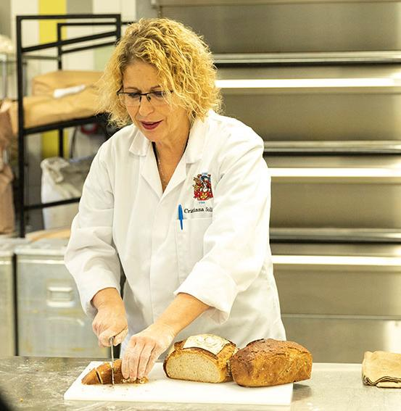
Course Information
We’re No. 1 in the UK for Research Intensity in Food Science (Complete University Guide 2021).
LSBU has the oldest Bakery School in the UK.
You’ll learn a number of different things across the discipline, from the art - and science - behind chocolate, bread and pastry production to the highly technical skills of baking chemistry, all-important food safety, and more.
The course could lead to the following: Management level - the inclusion of more scientific informed research coupled with analytical thinking, problem solving and project management, will prepare students for jobs in management roles. including include Production Manager/ Technical Manager/ Quality Assurance Manager/ Bakery Manager/
Visit our course webpage for more information.

Slide 7
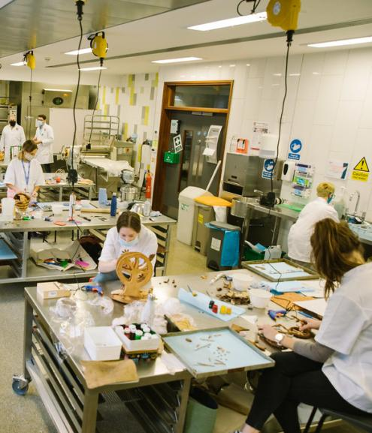
Entry Criteria
A Level BCC or;
BTEC National Diploma DMM/Certificate in an appropriate subject or;
Access to Science with 9 Distinctions 39 Merits or;
Equivalent level 3 qualifications worth 112 UCAS points
Applicants must hold 5 GCSEs A-C including Maths and English or equivalent (reformed GCSEs grade 4 or above).

Slide 8
What next?
Complete our feedback survey: https://forms.office.com/r/1jvcFVYGJb
Send us pictures, photocopies or videos of your activity: outreach@lsbu.ac.uk
Email us if you have any further questions or would like to explore further activity with us: outreach@lsbu.ac.uk
Visit our website: www.lsbu.ac.uk or explore our events page www.lsbu.ac.uk/discover

