Slide 1
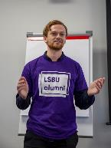
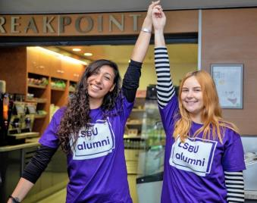
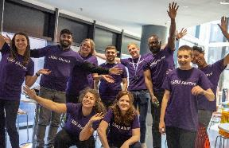
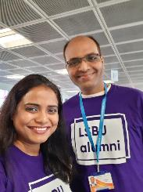
Your LSBU Alumni!
LSBU alumni are proud to give back their time to support your student journey and help guide you into the careers you want!
You might catch them sharing their real-world knowledge and experience with LSBU students at events, on career panels or through profiles. Make the most of their guidance and insight!
Joining LSBU Alumni can help you build professional connections and advance your career prospects.
You can join your LSBU Alumni community at any point – just sign up here! And follow us at:
@LSBUalumni @LSBUalumni LSBU Alumni Network

Slide 2
5 ways of giving:
Your alumni want to inspire you and be an example of what's possible. They do this by coming back to LSBU and giving back in the following ways....
Speaking to LSBU students
LSBU alumni can give back by sharing their career journeys, giving you practical advice and a very real picture of what’s possible.
Providing jobs, internships or work placements
LSBU alumni can give back by facilitating connections between the University and their organisation or directly offering jobs, placements or internships to LSBU students with their company.
Taking part in a profile We feature alumni role models that can inspire you and help you on your journey with valuable insights for life and top tips that give our students that extra-edge.
Talking to school pupils about University
LSBU alumni help break barriers to higher education for school pupils and college students by leading workshops to increase their confidence and raise their aspirations .Our alumni are an example of what’s possible and inspire students with their story.
Volunteering at LSBU Open Days
LSBU alumni can give back by sharing their experience and advice at Open Days, helping prospective students make one of life’s biggest choices – where to go to University?

