Slide 1
Organisational Development is essential to support systems change in primary care
Lessons from London’s Primary Care Quality Academies
March 2018
Prof. Becky Malby, Nick Downham, Tony Hufflett

Slide 2
We know that practices that are adapting are:
Using data to review their activity and improve flow within their practices and across the system.
Looking for examples and ideas to manage and meet demand from outside their practice.
Working collaboratively with local citizens in an asset based approach to reduce inappropriate demand.

Slide 3
High performing practices and primary care teams
Use their skill sets more effectively to meet need (diversifying their skills and offers, targeting these effectively)
Use their contact time with patients more effectively
Improve their back-office functions to be more efficient
Partner effectively with care homes/ other practices to manage the health of frail elderly in care and reduce hospital admissions
Work with Multidisciplinary Teams to flag at risk people and to solve complex needs.
Co-produce new services with communities

Slide 4
To adapt practices need
Data to catalyse inquiry, review unwarranted variation, inform demand management and work towards meeting demand.
Team development to secure collective decisions that stick and to hold fast on prototypes
Knowledge about quality tools and how to partner with communities. Learning provided through programmes and on-site using real issues/ real-time data as case material.
Help to view their practice as an interconnected system.
Support to prototype changes

Slide 5
The principles of our work
The development process is equally as important as the data
We need to engage fragmented groups and work as a system
Data from the practice itself is the most compelling
We are ‘Agnostic’ in approach (open to all solutions)
Working together for collaborative change
PCQA support
Current assumptions (provider and commissioner) don’t lead to solutions
Practice is overwhelmed and only able to enact minor tweaks

Slide 6
CONTEXT: Transitions and Challenges
From | To
Individual | Population
Increase Access | Reduce Demand
Consumers | Partners
Hunch | Evidence based decision-making
Top Down | Self-managed teams
Hierarchies | Networks & Collaborations
Expert | Learning
Notes:
The whole system linked to population health outcomes (systems approach & inequalities) e.g. Intermountain
Reducing demand e.g. Nuka
Citizens as partners and collaborators -asset based approach to the whole system e.g. Leeds
Data science as a core capability – robust evidence and intelligence informed decision-making e.g. Intermountain
Adaptive teams taking full professional responsibility e.g. Buurtzorg
Working collaboratively in Networks e.g Jonkoping

Slide 7
Rules of thumb that shape the NHS behaviour
At the founding of the NHS
Can do should do
Doing means treatment
Treatment means cure
I am responsible
In High Performing Health Systems
Partnering with People as Owners secures better health
We are responsible - partnership means everyone contributing
Do what matters and demand drops (People’s health is contextual)
Health is relational
You have to know what’s really going on (real-time data) in order to adapt and do better.
Meet rather than manage demand.
Currently
Private managers practices are more effective [than public service managers]
Outcomes can be measured easily
Human services are like manufacturing processes
Professionals always resist change

Slide 8
Many practices hold numerous hypotheses that shape their current work
Demand is rising
We are just meeting it but can’t carry on – we don’t turn people away
We don’t have enough capacity and we need more staff/ money
Frequent attenders all have more than one chronic disease
Secondary care shifts the burden onto us
Social care is failing

Slide 9
Using data and supported dialogue to catalyse inquiry and professional review

Slide 10
DATA #1 Understanding demand
Finding out what’s really going on

Slide 11
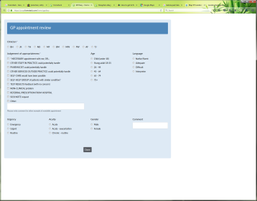
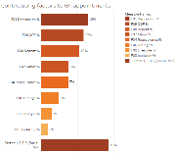
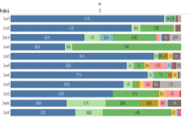
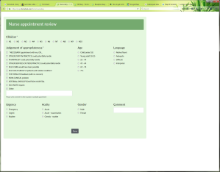
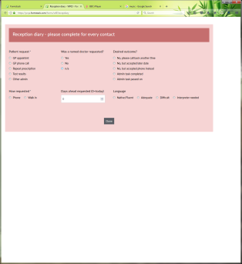
PRACTICE DIARIES are online webforms used to measure demand (met and unmet) and capacity (appropriateness)
❶
❷
❸
APPOINTMENT appropriateness
APPOINTMENT outcomes (next steps)
RECEPTION outcome of appointment requests
Process and report
Rapid turnaround
Discuss
React, Plan

Slide 12
The big picture of demand vs. capacity is optimistic
While typically 15% - 20% of appointment requests can’t be meet at reception in a practice
This is far less than the 40% of GP appointments that are seen as inappropriate – unnecessary, avoidable or potentially moveable within the practice
Unmet demand*
is far less than
Inappropriate
appointments
Reception contacts
GP appointments
Academies combined*
85% Yes
15%
No
60% appropriate
40%
Inapprop.
✓ Appointment booked
No appt possible
✓ Appropriate appt
* Over 10,000 contacts / appointments
** Not including missed calls

Slide 13
We illustrate GPs own assessment of appropriateness of appointments
Question to GPs: Should this patient be here today?
Answer from GPs: 40% of the time ‘no’
In a practice 30-50% of appointments are seen as inappropriate or moveable.

Slide 14
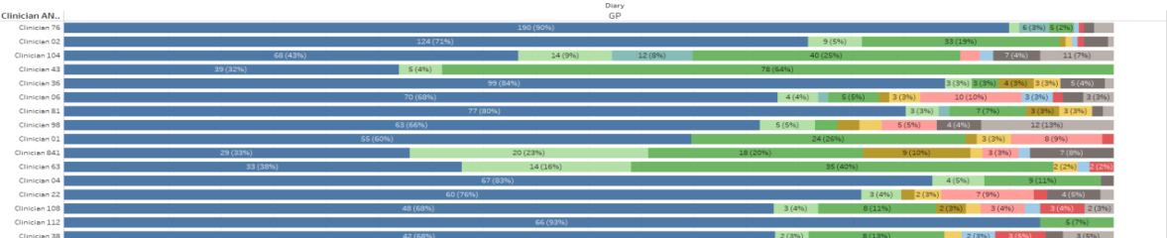
GP views: There is significant variation on what constitutes a GP appointment
Across practices….
Variation between practices from
‘ 80% of our appts are inappropriate’
to
‘less than 50% of our apps are appropriate’
Within practices….
Variation between GPS from 40% of my appts are appropriate to 90% are

Slide 15
Many practices are generally unaware of the extent and profile of patients that are turned away due to lack of appointments
  Some practices are unable to offer appointments to 25% or more of requests
  Some practices can fulfil nearly all requests
  Practices learn from peer comparison
Green = appointment booked
Red = appointment not available
⇨ Shown across the working day from 8am to 6pm ⇨

Slide 16
DATA #2 Reducing reactive care
Example: developing pro-active services by looking at frequent attenders

Slide 17





We simplify analysis for practices by using segments.
We help them understand the people who attend most frequently.
  The top 5% of patients may be using 20% of GP resources at the practice
  The practice may not be thinking in a joined-up way about how it is spending this resource
% of patients
% of appts
7x
5x
4x
3x
2x
1x
0.5x

Slide 18
We focus attention by illustrating the resources involved in helping people who attend the most.
  Thinking about groups in terms of £ value is motivating for a practice.
  We encourage practices to think about other ways of spending this money to help high attenders.
Frequent attender groups | range (appts/yr) | # patients | # GP appts | % of attenders | % of appts | Ave | Value* | Cumulative Value | £/head
 |  |  |  |  |  | appts/yr
A. Super attenders | 25+ | 17 | 537 | 0.3% | 2% | 32 | £26,850 | £26,850 | £1,500- £3,000+
B. Bi-weekly | 20-24 | 45 | 986 | 1% | 5% | 22 | £49,300 | £76,150 | £1,000
C. 3-weekly | 15-19 | 161 | 2,560 | 3% | 12% | 16 | £128,000 | £204,150 | £800
D. Monthly | 9-14 | 411 | 4,278 | 8% | 20% | 10 | £213,900 | £418,050 | £500
E. Bi-monthly | 5-8 | 1,046 | 6,507 | 21% | 30% | 6 | £325,350 | £743,400 | £300
F. Quarterly | 4 | 512 | 2,048 | 11% | 9% | 4 | £102,400 | £845,800 | £200
H. Infrequent | 1-3 | 2,676 | 4,778 | 55% | 22% | 2 | £238,900 | £1,084,700 | £90
Grand Total |  | 4,868 | 21,694 | 100% | 100% | 4.5
Non-attenders | Est. -> | 2,500
Example from a small practice, one year of appointment data

Slide 19
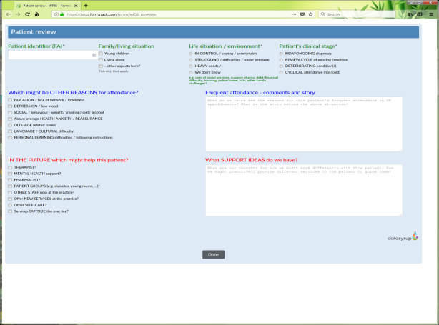
We guide GPs through case review and categorisation
  The top 5% of patients may be accessing 20% of GP resources at practices.
  It is usually assumed the people who access the practice frequently are elderly / people with multiple chronic disease. However this is not always the case. We help practices understand real need, rather than assumed.
Identifier | Age | Gender | GP appts | Nurse appts | Attender category | GP #1 % | GP #2 % | QOF registers | QOFs
1 | 64 yrs | Female | 46 | 5 | Super attender | 30% | 20% | 1 | CHD,
2 | 49 yrs | Female | 39 | 2 | Super attender | 62% | 15% | 1 | obesity,
3 | 51 yrs | Female | 35 | 6 | Super attender | 86% | 14% | 3 | cancer,mental_health,obesity,
4 | 97 yrs | Female | 35 | 1 | Super attender | 54% | 46% | 1 | atfib,
5 | 52 yrs | Male | 34 | 4 | Super attender | 38% | 26% | 1 | depression,
6 | 23 yrs | Male | 33 | 4 | Super attender | 67% | 12% | 1 | learning_disability,
7 | 47 yrs | Female | 33 | 0 | Super attender | 70% | 15% | 0
8 | 64 yrs | Female | 33 | 4 | Super attender | 33% | 27% | 2 | CVD,hypertension,
9 | 72 yrs | Female | 32 | 7 | Super attender | 56% | 16% | 1 | stroke_tia,
10 | 37 yrs | Female | 30 | 9 | Super attender | 27% | 23% | 1 | asthma,
11 | 62 yrs | Male | 29 | 5 | Super attender | 28% | 28% | 3 | asthma,CVD,hypertension,
12 | 63 yrs | Female | 28 | 2 | Super attender | 46% | 29% | 1 | diabetes,
13 | 48wks | Male | 26 | 3 | Super attender | 38% | 23% | 0
14 | 61 yrs | Male | 26 | 1 | Super attender | 23% | 23% | 3 | asthma,cancer,depression,
15 | 46 yrs | Female | 26 | 0 | Super attender | 73% | 27% | 2 | depression,mental_health,
16 | 56 yrs | Female | 26 | 2 | Super attender | 54% | 19% | 0
17 | 96 yrs | Female | 26 | 2 | Super attender | 65% | 27% | 2 | CKD,dementia,
18 | 48 yrs | Male | 24 | 2 | biweekly | 46% | 17% | 1 | depression,
TOOLKIT: a webform prompts consideration of:
Patient’s life situation
The real drivers of high attendance
New services / skills and ideas

Slide 20
Sorting the work
Assembling our knowledge and planning change

Slide 21
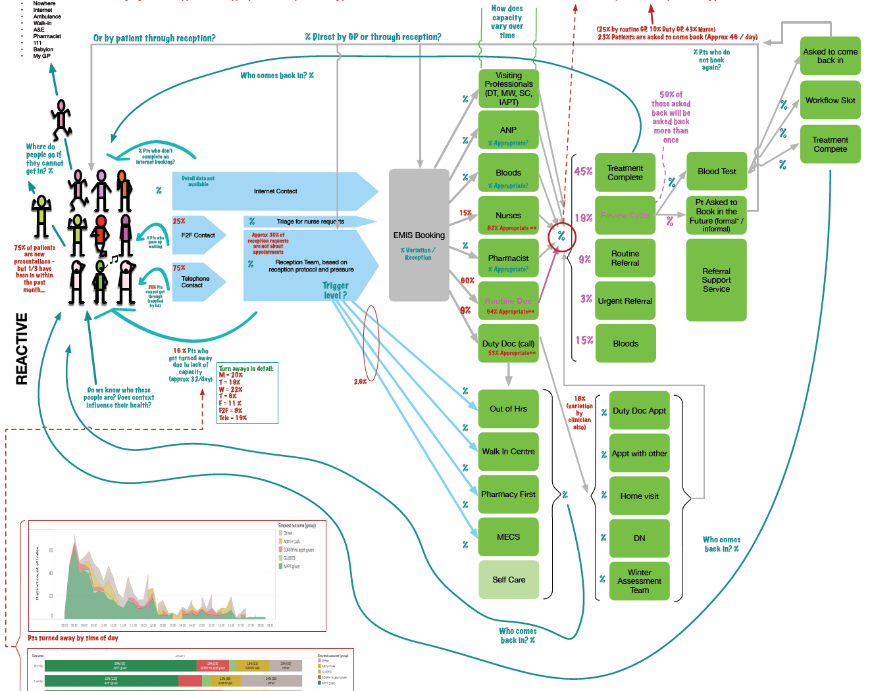
We help practices understand their practice as an interconnected system – and that GPs do have a role in generating their own demands.
  We create a system map of each practice.
  We help practices move from tinkering around the edges of change(things like correspondence management) to fundamentally challenging their system of work.

Slide 22
GP based triage
Nurse based triage
Classic
GP triage
Nurse triage
Reception
Reception signposting
Reception
Signposting

Slide 23
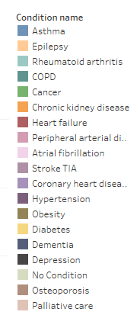
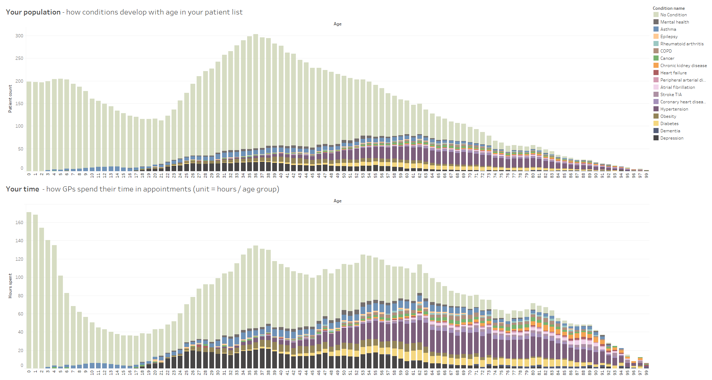
Standing back and looking at the whole practice population – example from one practice.
Long term condition register (QOF) - occurrence by age/across appts
LTC occurrence by patient
Proportion of GP appts taken by long- term conditions
Age 0 -100 years ⇨

Slide 24
Case Study (1)
The immediate impact of team development and sorting

Slide 25
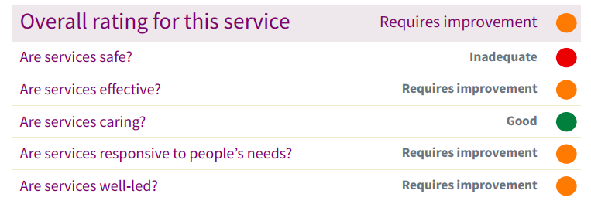
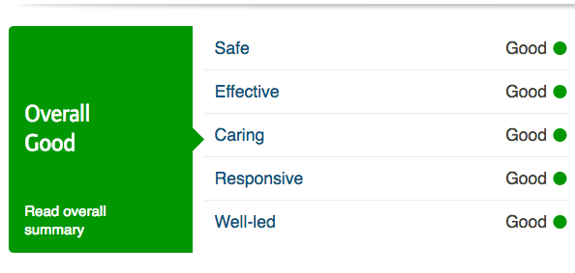
Case: impact – CQC ratings
Practice List Size 14,000.
The practice is in the 7th most deprived borough in London and the 35th in England.
November 2015 (prior)
January 2018 (during)

Slide 26
Case study: intervention list
What we did | When
Data Readiness – the first data diary on appointments | June 2017
3 day Core Concepts of Quality Course for 5 members of the practice | June 2017
9 days of onsite development – practice team relationship development; coaching the lead partner; QI, flow; measurement, new triage; workshop facilitation, coaching the team to implement prototype; keeping the heat up with data reviews; frequent attender review; moving from meeting to managing demand to the aim to reduce demand. | September to present. Implementation of prototypes from November 2017
Communities of practice sharing the granular details of how to change the practice system | September to present x 3

Slide 27
Case study: Benefits 6 months in
Reduction in required GP resource - salary of £71,000 plus 12.8% National Insurance contributions and 14% employer's superannuation – a total of about £90,000. Currently reviewing how to invest this in meeting rather than managing demand.
Lower use of locums over Christmas. GPs taking the usual Xmas holidays so no change in practice staffing.
Appointment demand spread over the day more evenly and now only 7% patients turned away (because they don’t want what is offered) – everyone is seen or given an appointment (Telephone triage /GP/Other service).
Seeing 35% more patients a week.
DNAs reducing.
Improved CQC from Requires Improvement to Good across all aspects
Additionally
PPG very supportive of the changes, and staff say stress levels are down.
Notes:
Moving practices from a place of externalising issues and / or head in the sand to taking major steps in changing ways of working.
Moving senior teams to agreement on the need to change.
Clinical leaders closer together

Slide 28
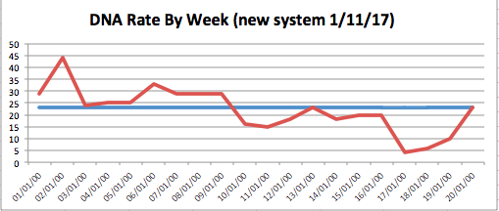
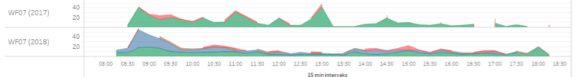
Data results
Illustrating it takes time for a practice to develop the skills in new models.

Slide 29
Case: The Practice Next Steps
Considering bringing in walk in (removes the sorting step),
Social (contextual) focused proactive work on super attenders
Community Collaboration –working with their community as assets by helping to develop networks
Developing stronger relationships with formal services in the community
Skill mix development (team based)

Slide 30
Collaborative Practice
Examples of what we are expecting to gain from previous experience.

Slide 31
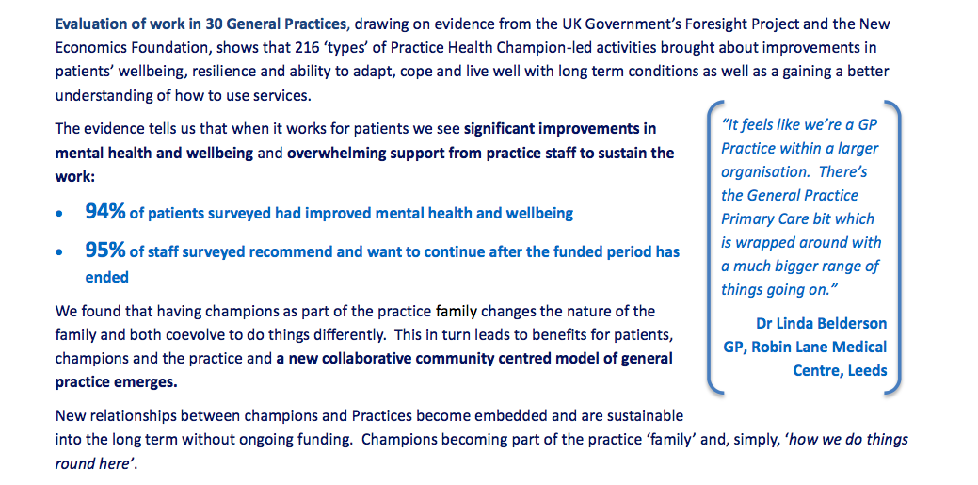
Impact

Slide 32

Robin Lane - Coproduction
“We have increased our patient list by 4,500 people, that’s a 57 % increase, and we have seen no increase in demand for either primary or secondary care consultations because we do things differently.”
Mev Forbes, Managing Partner, Robin Lane Medical Centre

Slide 33
The Ideal Primary Care System
A Straw Man – starting from needs

Slide 34

An ideal primary care system
Possible categories of Complex need
Frail older people
Elderly with multiple needs
Trouble with life
MH and Physical Health
Children & Young
Health
and
care
system
Complex &
unstable
MDT @ home – the number of visits/meetings can probably be pre-determined by type of need and forms the pathway.
Tele-health to secondary care
Assessment for Early warning flags
REQUIRES: Continuity of GP/team
REVIEW & PLAN: MDT Reviews
ASSESS: E-record flags
Comprehensive assessment at home
Purposeful
Potential
to tip
Sorting
Additional reviews based on need:
Clinical; Social; Poly pharmacy
Complex
stable
RESOURCEFUL COMMUNITY connecting people / creating meaningful activities / generating self-esteem
Clinical
System
Prevention
& early
diagnostics
ASSESS : E-record flags
REVIEW: of potential for complexity
MINOR
ACUTE & DIAGNOSE
ACUTE & IMMEDIATE ESCALATE
PAPERWORK
PAYMENT SERVICES
ROUTINE DIAGNOSTICS
Transactional
Urgent
care
House-
keeping /
routine

Slide 35
What it Takes
To do this work

Slide 36
What it takes to do this work (principles)
A neutral non-judgmental academic partner willing to walk alongside the practices as they develop; but also rigorous and challenging/ critical friendship
We start with what’s really going on in the practice using data and system maps to understand the patterns of behaviour
We work with their real time current issues – we start where they want to start
We sort and filter all the advice available to general practice on quality and change
We work with the practice as a system not a series of parts that can be fixed mechanistically - we start anywhere and go everywhere
  across appointment systems and how people move through the system;
  clinical and management variation in signposting,
  referral and clinical decisions;
  skill mix – who does what work;
  building the assets of the communities; working with the folk who are struggling

Slide 37
What it takes in practice
Our team has expertise across all the emerging needs of the practice, with a portfolio of primary care specific methods – QI methods, Data, Citizen engagement and asset building; team development and peer decision-making; clinical variation; working as a system.
We build the relationships that enables them to decompress – we listen (for hours) meaningfully to their experience, assumptions and opinions.
We reframe the issues so that they relate directly to the practice’s business
We respect their learning and creating headspace and a learning environment
We secure pace and spread through Communities of Practice
We work with the top of the system to generate accountability for the issues that reside at the whole system level
We walk practices through their challenges. Depersonalising and de-externalising them.

Slide 38
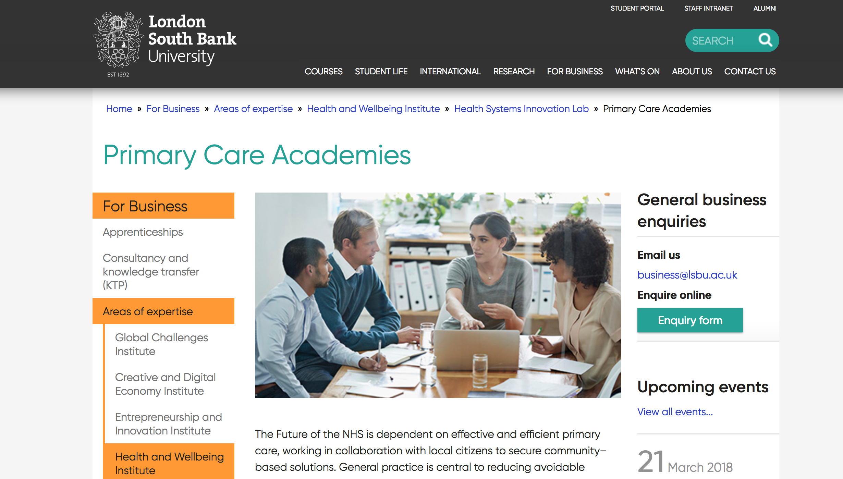
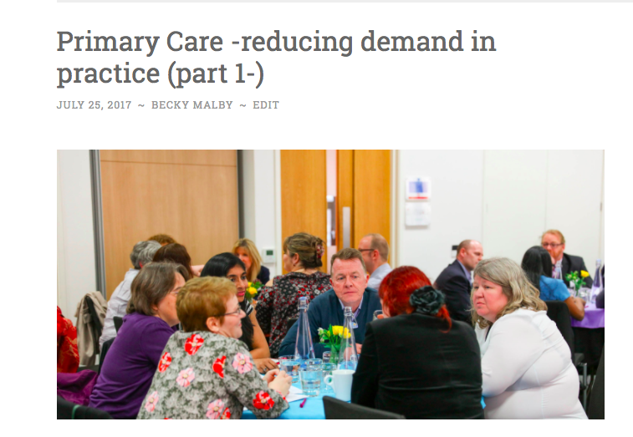
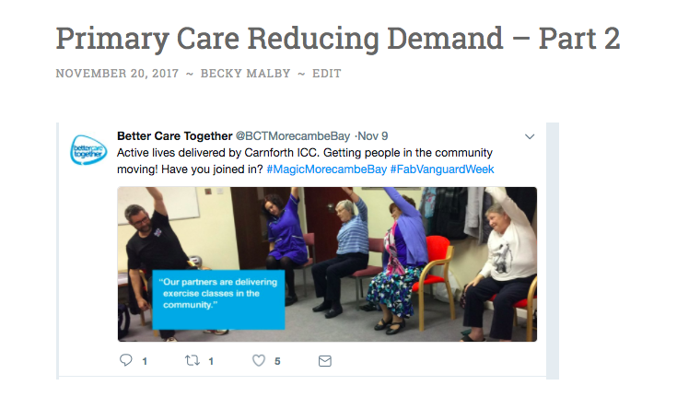

https://beckymalby.wordpress.com/
r.malby@lsbu.ac.uk
@BeckyMalby

